Slide 1
Proactive Health Coaching with complex patients
Workshop
September 2016

Slide 2
Background information
Health Navigator is an organisation focused on innovative behavioural interventions and offers a Proactive Health Coaching (PHC) service for patients with frequent non-elective admissions and A&E attendances
This material has been developed with the aim of increasing the understanding of PHC, and to give some background to the intervention
This material should be regarded as preliminary and confidential, and is only complete together with the relevant verbal presentation. This material should therefore not be distributed without prior agreement.
For more information about this material and PHC please contact Karin Hogsander (Interim Managing Director) at karin.hogsander@health-navigator.co.uk

Slide 3
What is your experience of health coaching with complex patients? Why is health coaching particularly impactful for these patients?
Notes:
15 min – find out what’s important for people around table

Slide 4
For complex patients, the health coach may be the first person to get a complete picture
“
“
You’re the first person I’ve been able to sit down with and review my whole situation…
Washington Post and KHN April 2013
Guardian 28 Aug 2016
BBC 29 Aug 2016

Slide 5
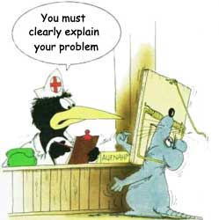
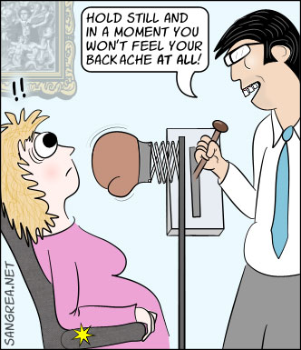
Do you recognise the frustrated, demotivated patient?
Often, patients and clinicians don’t speak the same language, especially in complex cases…
… or the problem being fixed causes other issues or isn’t what the patient wants to address.

Slide 6
What time split of a health coach between coaching patients/ coordinating care around patients’ needs are you seeing?
Coaching of patients
Contact other care providers
Contact relatives
Healthcare contacts
2%
Teaching
15%
18%
Contact welfare officer / social worker
3%
Contact municipality
5%
Establish new health care center contact
17%
Support to self care
5%
Contact nurses and community services
5%
5%
Appointment booking
13%
14%
Motivating dialogue
Contact with GP
Source: Health Navigator analysis of Swedish activity data

Slide 7
Patient case: How would you approach “Karl” – a complex patient who attends A&E frequently?
Background
Person
Male, Mid 70’s
Married, living w wife
No exercise, does not drink much fluids
Medical history
Stroke and hypertension
Cancer of bladder
Cataract
Recent care events
(last 12 months)
9 A&E attendances
Main gaps
Actions and planning
Early results
No treatment/management plan in place from GP
Awaiting consultant appointment and scan
Anxious and worries about cancer returning
Pain, and lack of knowledge about symptoms and therefore attends A&E frequently
Low confidence and motivation to follow up with GP
Arrange GP appointment to review pain control
Contact medical secretary to ask for reduced waiting time for follow up with consultant after scan
Discuss symptoms with patient to identify any gaps in knowledge
Increase fluids to reduce risk of urine infection
Motivation calls to increase confidence to act proactively
1 A&E since enrolled in Proactive Health Coaching
Reviewed plan and pain control with GP
Consultant confirmed no cancer
Now talks about his anxieties, and is able to manage and understand his physical symptoms better
Commenced medication to alleviate symptoms
Phased out with no further care events
Now able to manage and understand his physical symptoms better

Slide 8
Thank you!
Karin.hogsander@health-navigator.co.uk

